Slide 1


Term Project:
Applebee’s Twitter Analysis

Slide 2
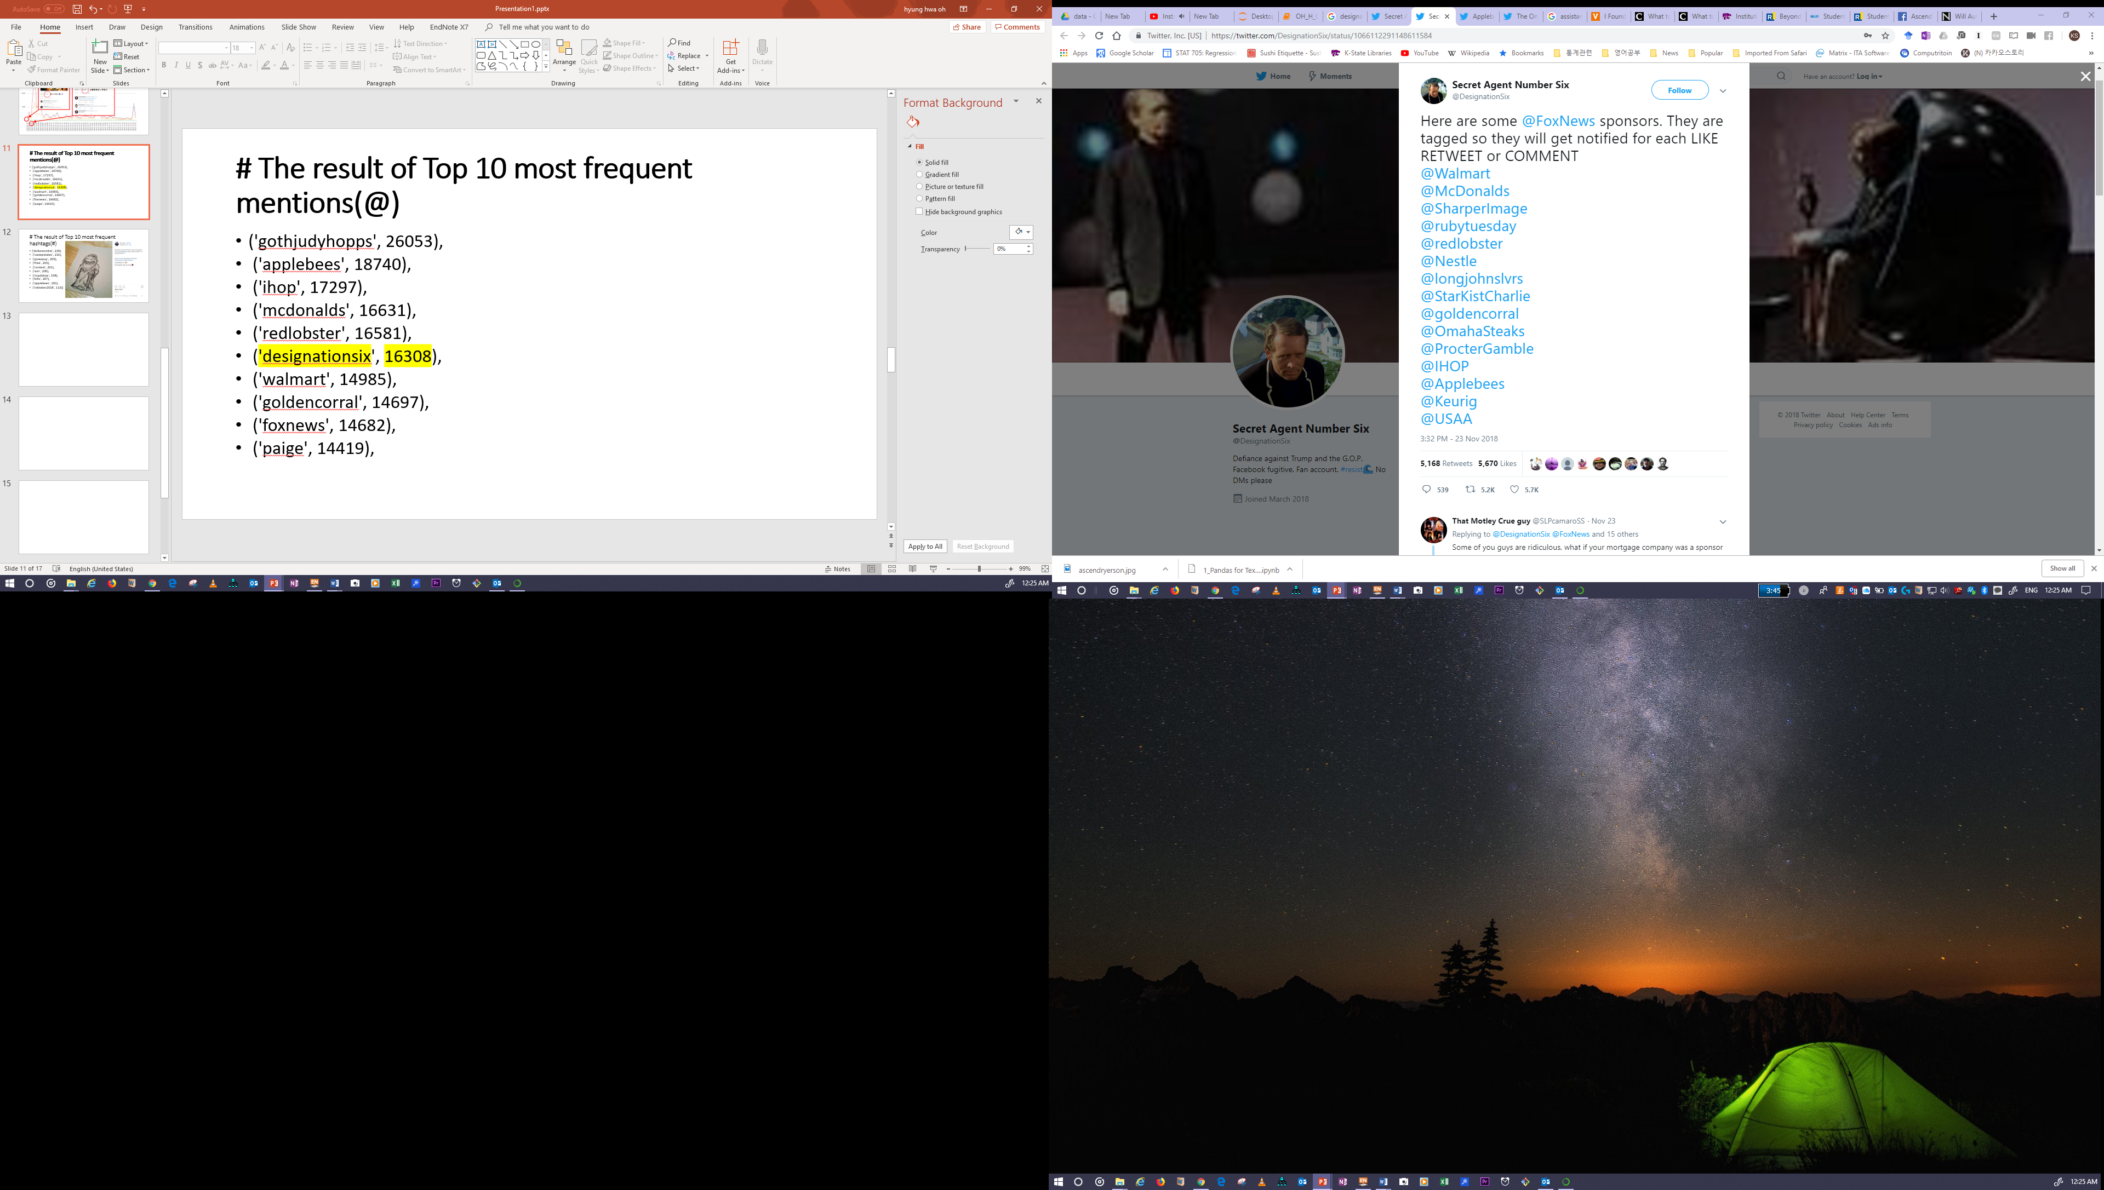
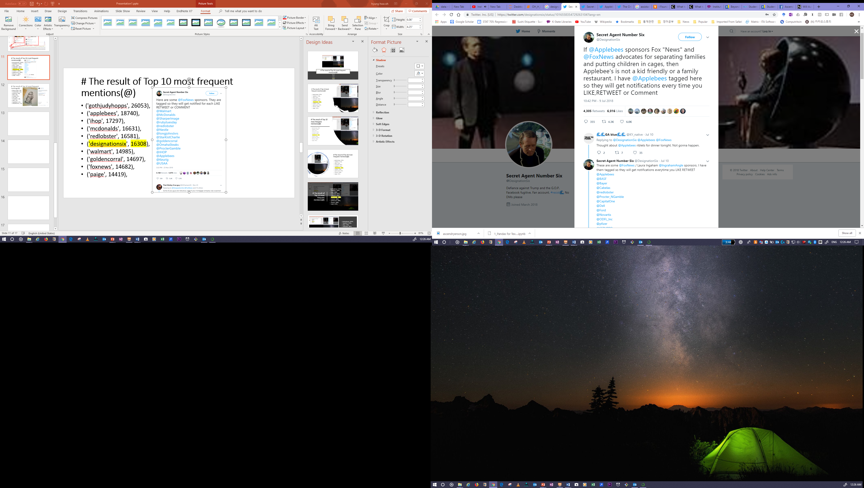
# The result of Top 10 most frequent mentions(@)
('gothjudyhopps', 26053),
('applebees', 18740),
('ihop', 17297),
('mcdonalds', 16631),
('redlobster', 16581),
('designationsix', 16308),
('walmart', 14985),
('goldencorral', 14697),
('foxnews', 14682),
('paige', 14419),

Slide 3
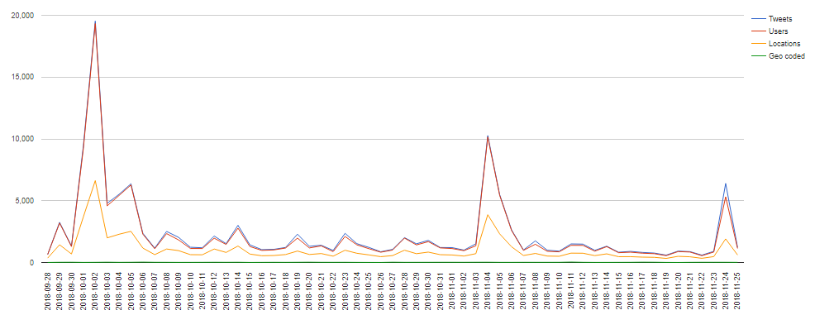
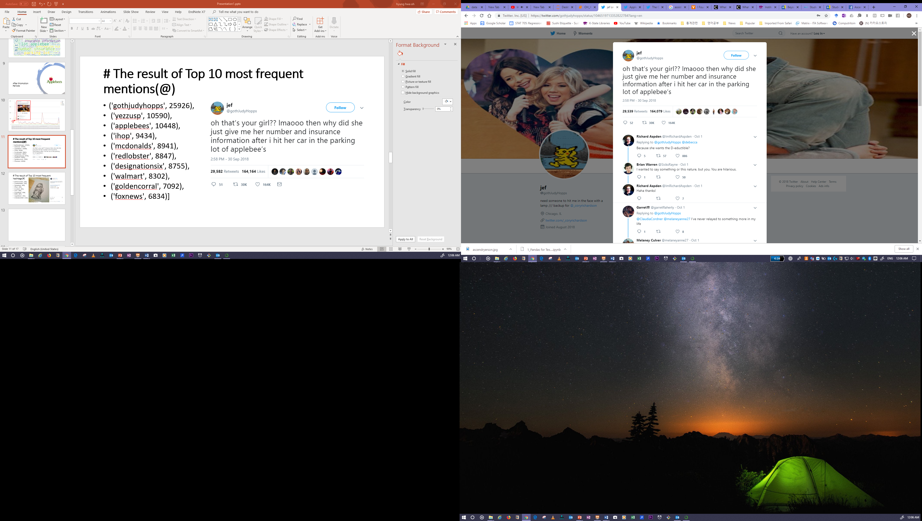
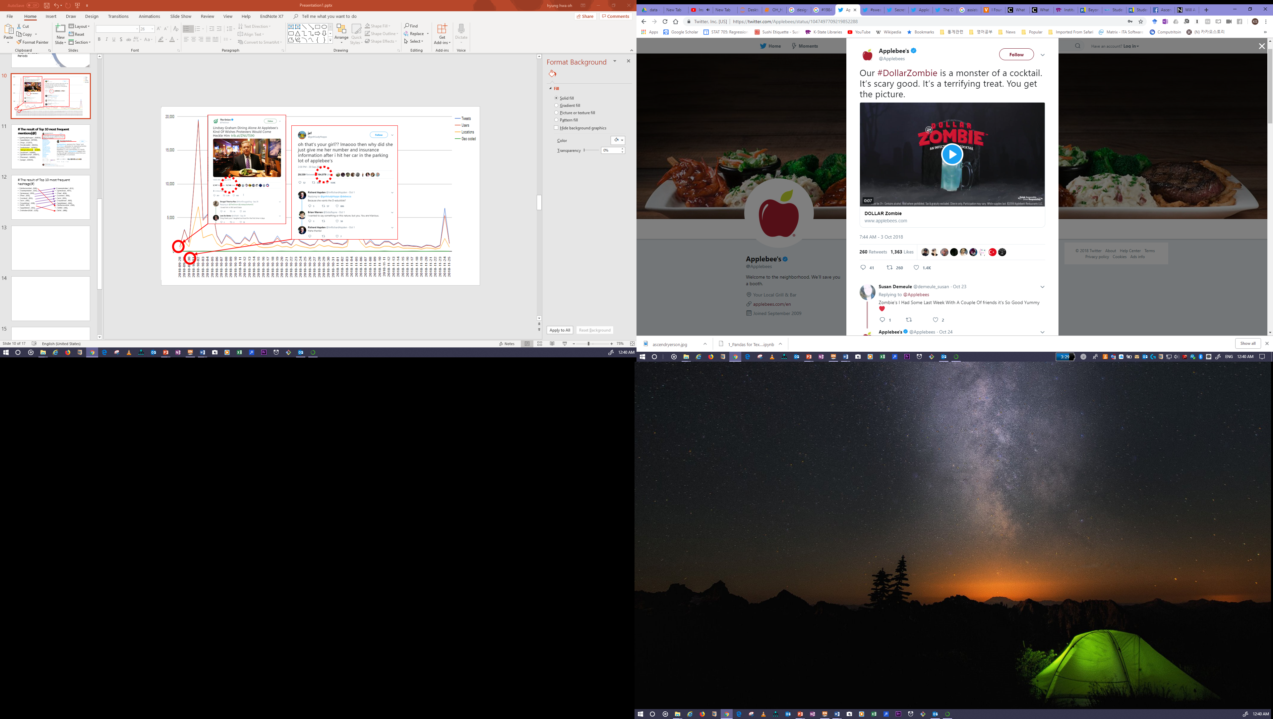
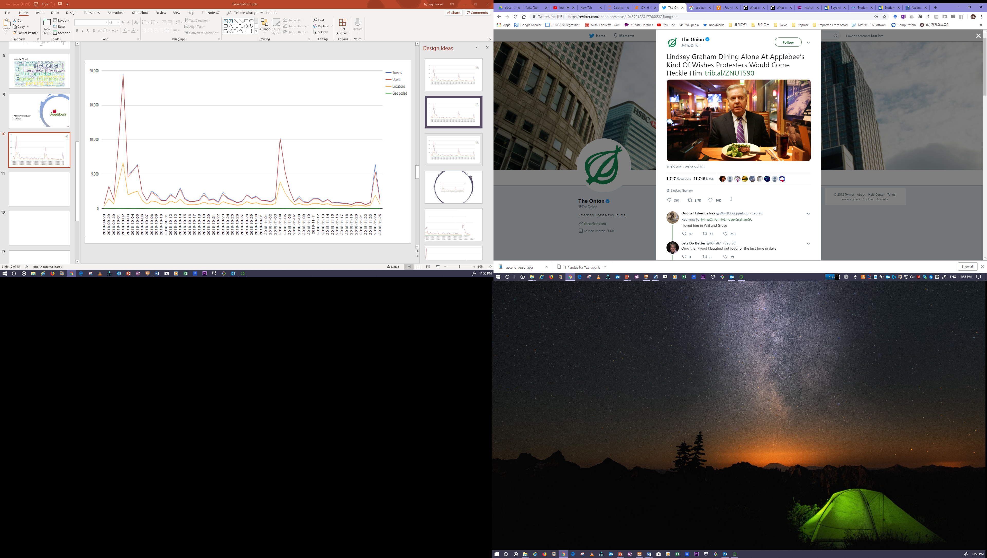

Slide 4
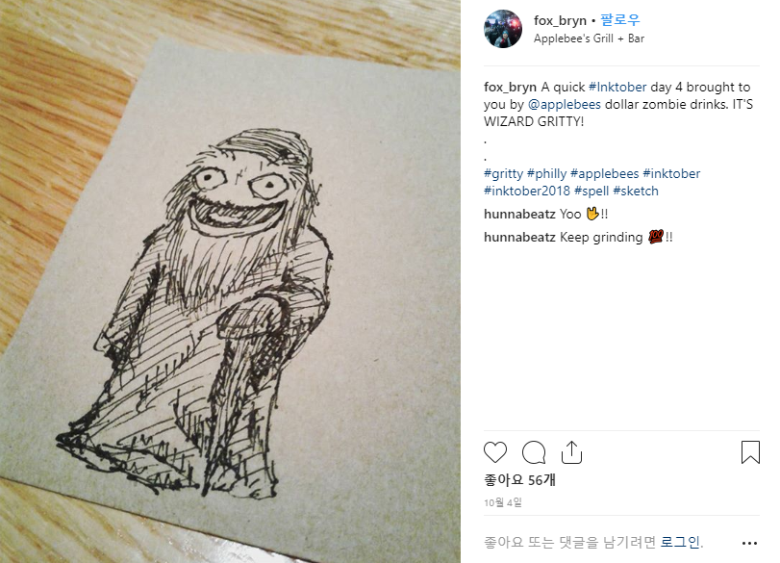
# The result of Top 10 most frequent hashtags(#)
('dollarzombie', 238),
('sweepstakes', 216),
('giveaway', 209),
('free', 205),
('contest', 201),
('win', 200),
('royaldraw', 198),
('bills', 187),
('applebees', 181),
('inktober2018', 113)]

Slide 5
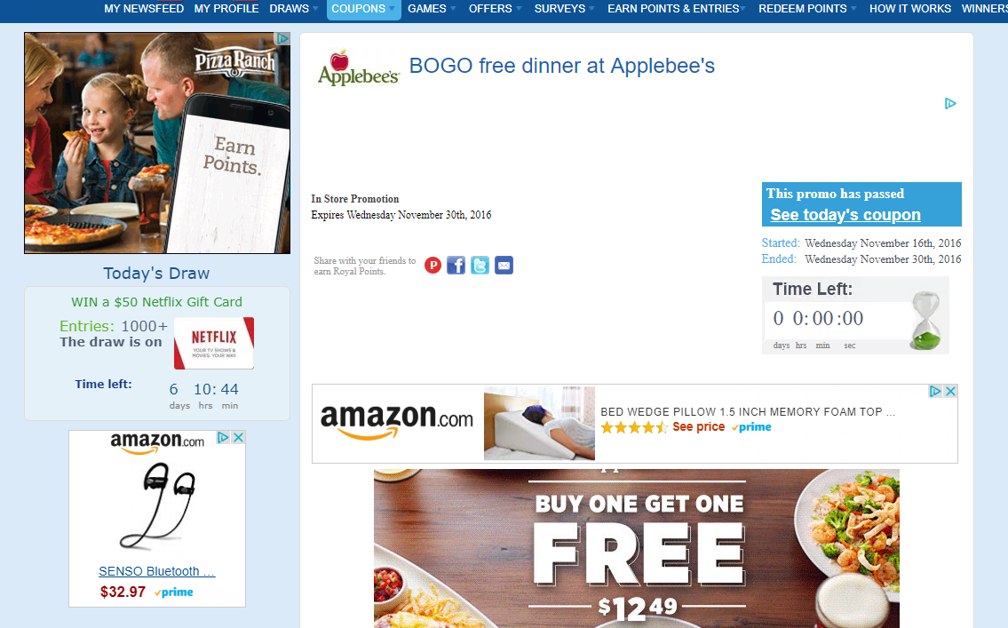

Slide 6
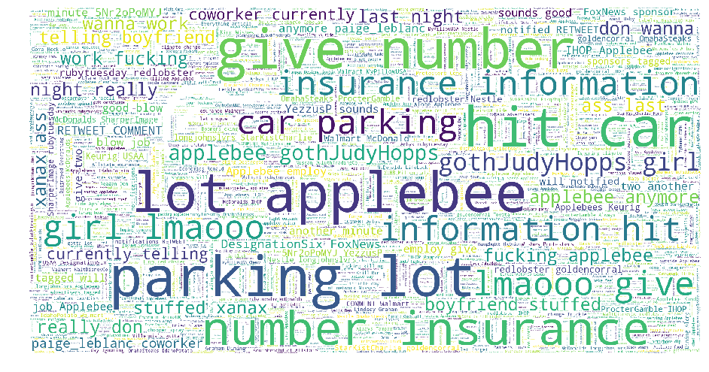
Words Cloud

Slide 7
Results without Noises (Retweets)

Slide 8
## - What is the sentiment about Applebee’s?
- Summary of Sentiment Analysis Result using Vader¶
Positive Tweets: 12,727 (40%) / Negative Tweets: 7,792 (25%) / Neutral Tweets: 11,275 (35%)
- Summary of Sentiment Analysis Result using Vader¶
Positive Tweets: 3,196 (43%) / Negative Tweets: 1,765 (24%) / Neutral Tweets: 2,530 (34%)
Before Promotion Periods
After Promotion Periods

Slide 9
Applebee’s: 11/12-12/30 Promotion: Drink of the Month Veteran’s Day (free meal for veterans)
Before Promotion. Positive Words
Promotion
- ('free', 971), ('veterans', 667), ('card', 508), ('win', 506), ('zombie', 439), ('gift', 351), ('royaldraw', 352)
Time
- ('sunday', 284), ('night', 394), ('tonight', 317)
Menu
-('drinks', 506), ('wings', 480), ('grill', 430), ('meal', 359), ('dinner', 292), ('food', 636)
Restaurant Outlet
-('bar', 590)
Others
- ('people', 375), ('party', 375), ('friends', 272)

Slide 10
Applebee’s: 11/12-12/30 Promotion: Drink of the Month Veteran’s Day (free meal for veterans)
After Promotion. Positive Words
Promotion
- ('win', 398), ('royaldraw', 346), ('free', 311), ('card', 294), ('egift', 191), ('contest', 179), ('sweepstakes', 175), ('giveaway', 175), ('gift', 111)
Time
- ('tonight', 80), ('night', 121)
Menu
- ('grill', 143), ('dinner', 105), ('meal', 74)
Restaurant Outlet
- ('bar', 161)
Others
- ('friends', 76), ('people', 92)

Slide 11
Applebee’s: 11/12-12/30 Promotion: Drink of the Month Veteran’s Day (free meal for veterans)
Before Promotion. Negative Words
Bad words
Foxnews sponsors
('ihop', 523), ('redlobster', 376), ('redlobster', 376), ('walmart', 309), ('goldencorral', 297), ('foxnews', 334)
Promotion
- ('zombie', 170),
Menu
- ('wings', 365)
Employees Discrimination
-('waitress', 297), ('black', 252), ('racist', 201)
Others
- ('people', 351), ('drunk', 346), ('drink', 170),

Slide 12
Applebee’s: 11/12-12/30 Promotion: Drink of the Month Veteran’s Day (free meal for veterans)
After Promotion. Negative Words
Bad words
Foxnews sponsors
Restaurant Outlet
- ('bar', 59)

Slide 13
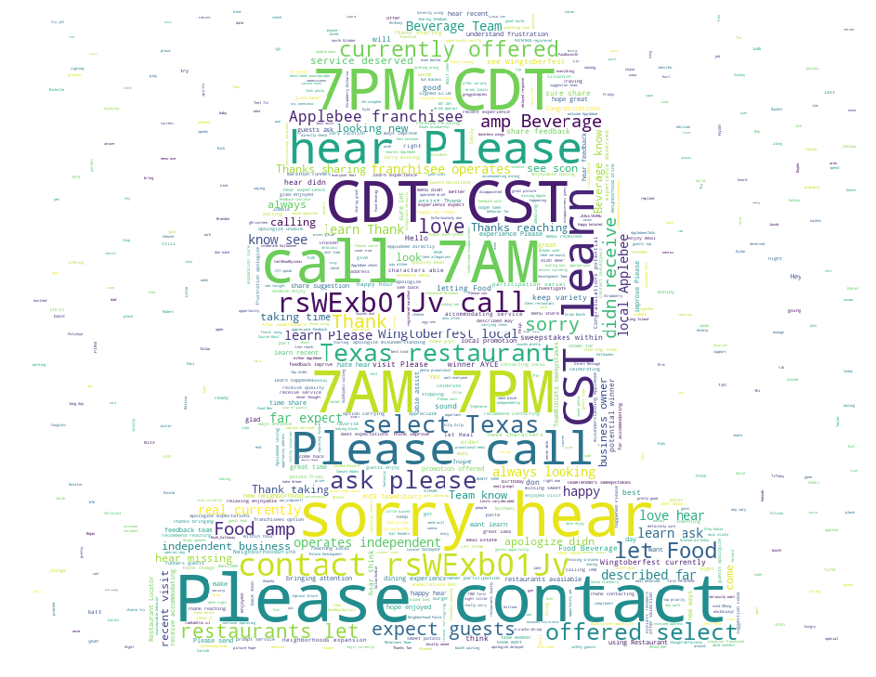
## - How Applebees use its twitter account? Customer Service? Sales? Promotion?
Applebees uses its twitter account for resolving service failures.
The word could describe customer service related words such as 1. (please', 'contact'), 699, 2.('sorry', 'hear'), 562, 3.('call', 'cdt'), 521, 4. ('please', 'call'), 306, 5.('contact', 'call'), 290.

Slide 14
Summary of topic modeling
Topic Modeling with cleaned data using Vader Package
Data sets included four different sets
(1.Positive with Before/2. After; 3.Negative with Before/4. After)
15 Topics Identified

Slide 15
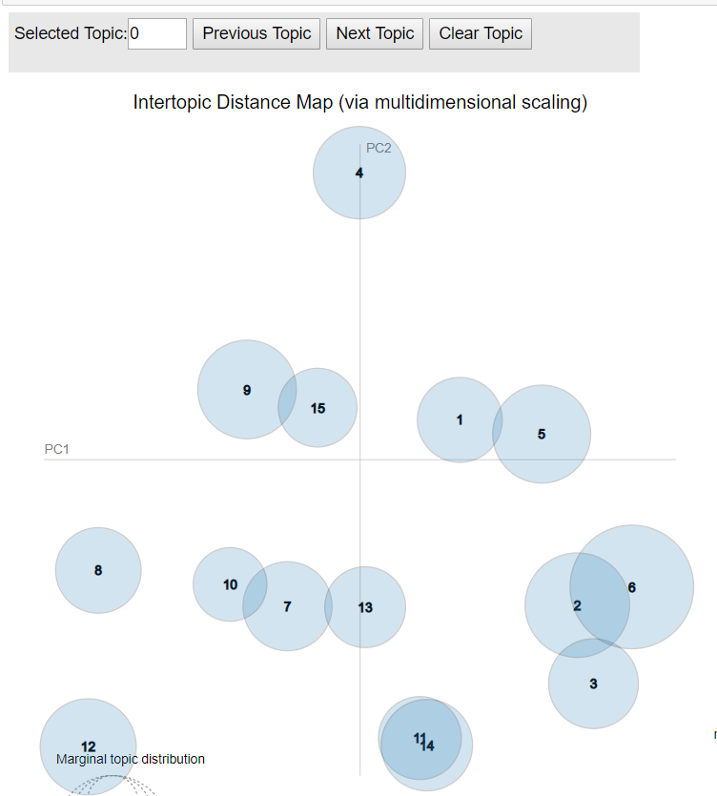
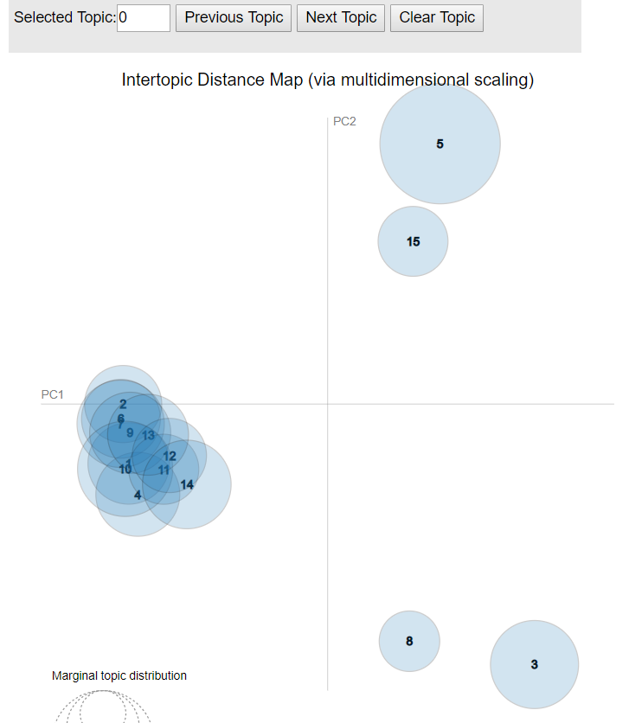
Intertopic Distance Map Before and After – Positive Topics

Slide 16
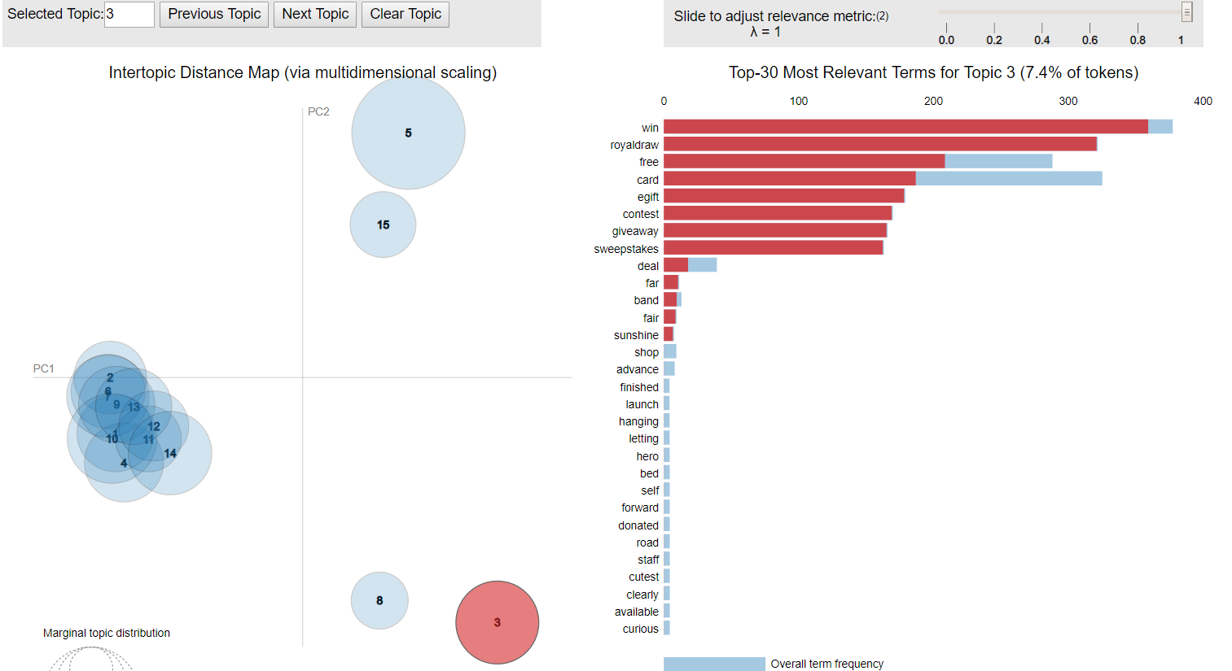

Topic Modeling Groups - Positive
Group 1
Topics 3 and 8 are both positive topics that are more prevalent after the promotion.
These topics directly relate to gift cards and Applebees promotions.
Group 2
Promotions through word of mouth and tweets were very popular as the topics clustered in the bottom left corner are in relation to customer experience.
Group 3
Not as relevant as they contain fox news sponsors and other businesses prevalent in both before and after promotion.
Group 3
Group 2
Group 1

Slide 17
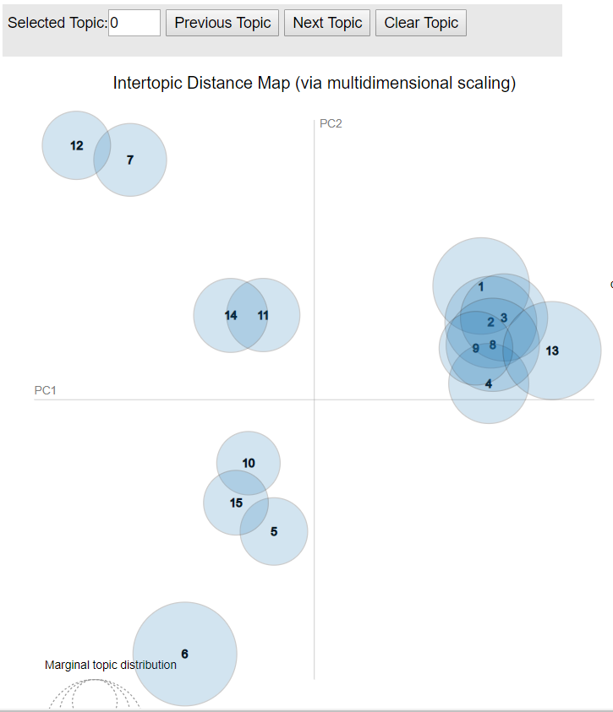
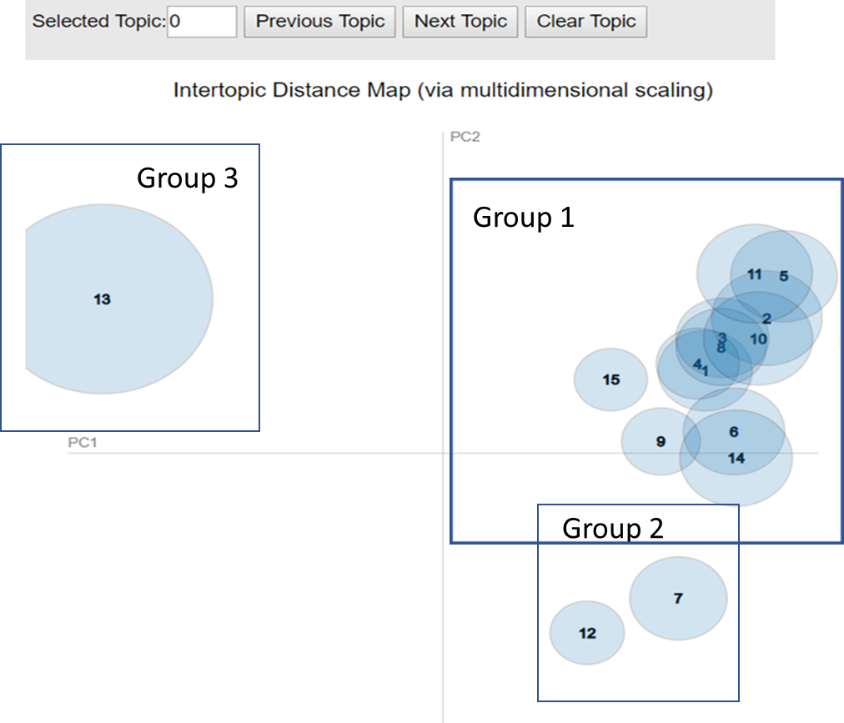
Intertopic Distance Map Before and After – Negative Topics

Slide 18
Top 3 Positive Tweets Before Promotion
Original Tweet | Sentiment Score (Vader)
1. ['happy happy birthday from and you wish was our birthday can party too pitter used work here great years friendship and many more happy birthday our best friend and vlogger'] | 0.9847
2. ['happy sweet siaa siaa you are beautiful young lady very proud you hope you enjoyed your day best wishes and lots love eating day celebration grill bar'] | 0.98413
3. ['happy pre veterans day don forget tomorrow head your neighborhood celebrate with free meal for active duty and veterans because loves you all thank you for your support and love millionmeals heroes'] | 0.9816

Slide 19
Top 3 Positive Tweets After Promotion
Original Tweet | Sentiment Score (Vader)
1. ['email today had the lovely pleasure serving your basketball team warrensburg missouri had great conversation and they were outstanding young men just wanted pass along good word that your team full some great players'] | 0.9738
2. ['seanschemmel toeianimation happy happy birthday from you wish was our birthday can party too hey happy birthday man you are literally idol enjoy your super birthday'] | 0.9738
3. ['enjoying this evening with grandpa who one our favorite veterans brave thankful blessed loved kindsoul grill bar'] | 0.9694

Slide 20
Top 3 Negative Tweets Before Promotion
Original Tweet | Sentiment Score (Vader)
1. ['fake fake fake fake call fake alert fake fake fake fake kdka don tip black people waitress kentucky was given racial note instead tip'] | -0.9769
2. ['news was being bullied north star mall was being hit violent manner more then two employees was told face that the color skin scared discrimination bullying verbal abuse sexually harassed'] | -0.9735
3. ['had horrible day ordered thinking have easy dinner after this hellish day nope half our order was messed missing the five year old now angry tears and refusing ever get again and head pounding worst day ever'] | -0.969

Slide 21
Top 3 Negative Tweets After Promotion
Original Tweet | Sentiment Score (Vader)
1. ['made the mistake seeing this horror movie and gave such bad panic attack that ran out and currently crying the bar '] | -0.959
2. ['thisvis defamatory propaganda machine foxnews should sued blatant lies considered treasonous don buy products from their sponsors shame proctotsndgambol nestle ford subaru really redlobster walmart the worst mondaymotivation end the lies'] | -0.9552
3. ['least stores work have closed was sexually harassed manager missed out the lawsuit coworkers had him manager fired luna park for telling him suffer from depression have many harsh truths about work experience'] | -0.9552

Slide 22
Summary of topic modeling
Structural Topic Modeling (STM) was used
137,708 tweets were analyzed for topic modeling
The number of topics was determined as 50.

Slide 23
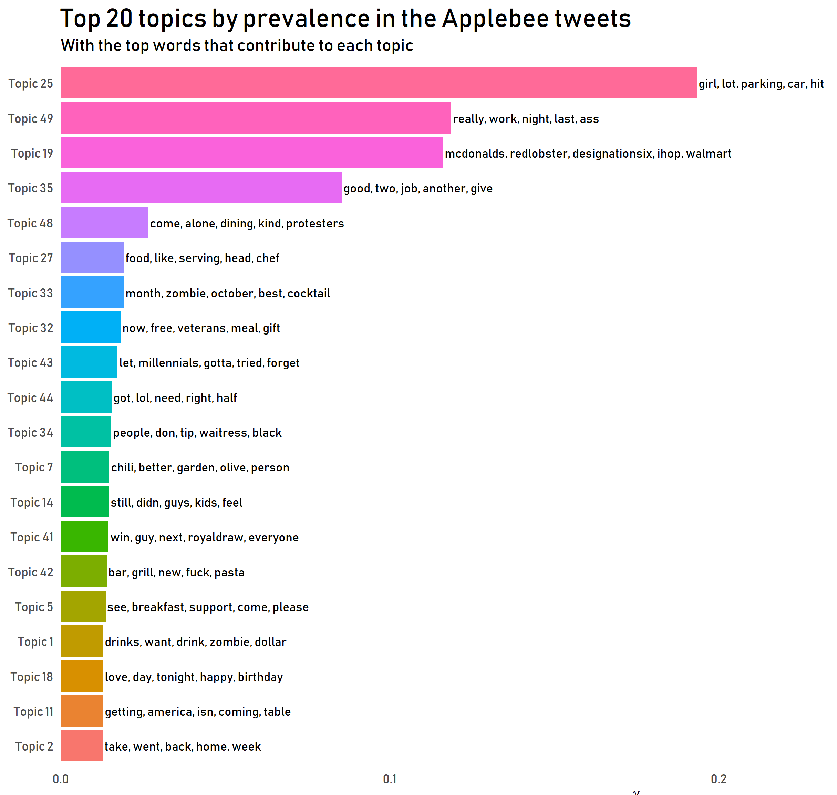
The most popular topic
Topic 25: Parking lot (#1)
Topics related to Applebee’s marketing
Topic 33 and 1: Dollar zombie (#7 and #17)
Topic 32: Veteran’s day and gift card (#8)
Others
Topic 34: Discrimination of Applebee’s employee (#11)
Topic 16: Business decisions made by Applebee’s and ihop

Slide 24
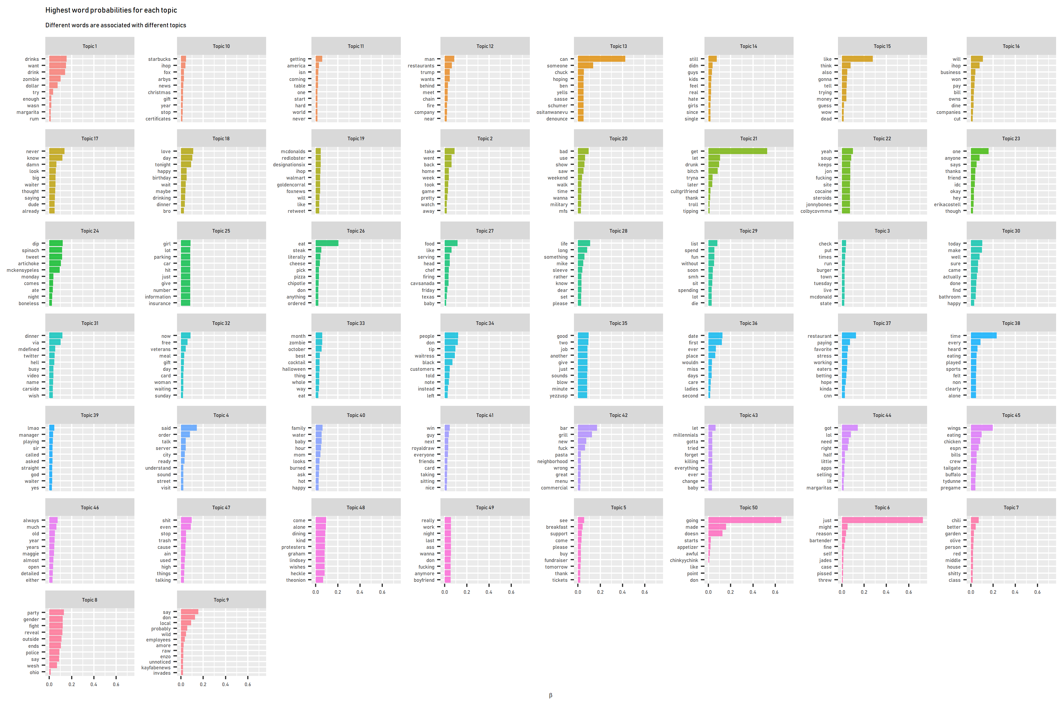
Veteran’s day and gift card
Dollar
Zombie

Slide 25
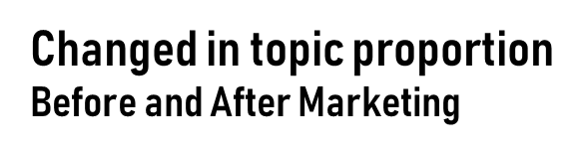
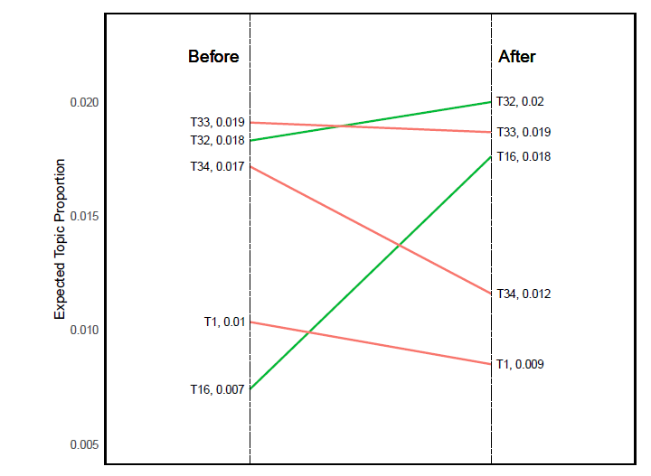
Marketing Effectiveness
Increase in topic proportion
Topic 32: Veteran’s day and gift card
Topic 16: Business decisions
Decrease in topic proportion
Topic 33: Dollar zombie
Topic 1: Dollar zombie

Slide 26
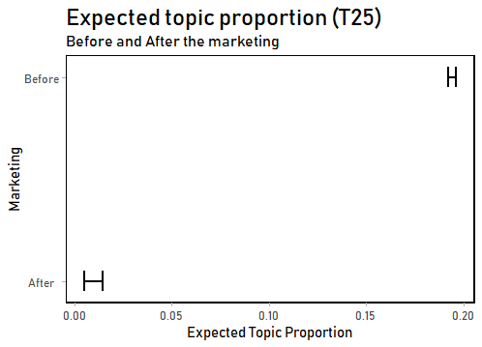
Parking lot topic
Decreased significantly!

Slide 27
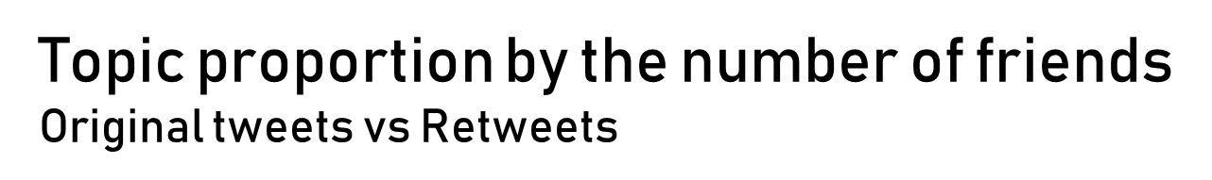
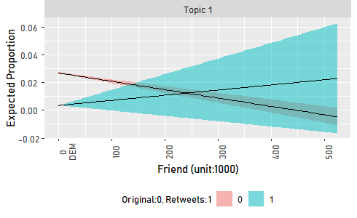
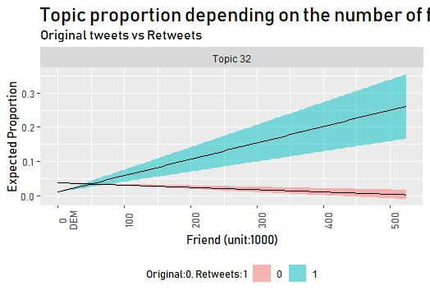
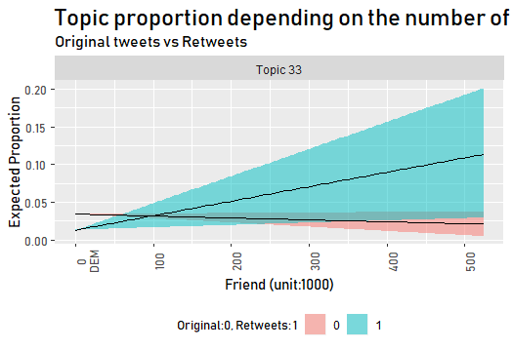
T32: Veteran’s day and gift card
T1 and 33: Dollar zombie

Slide 28
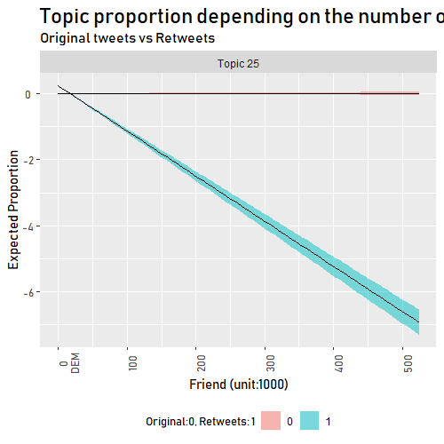
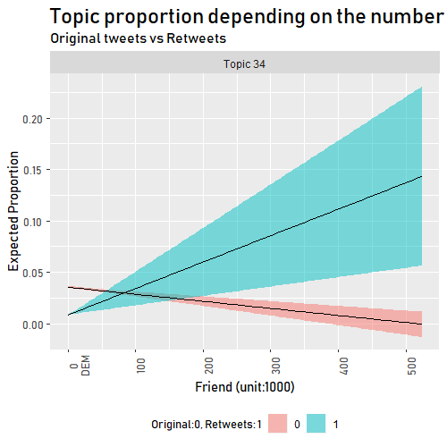
T25: Parking lot
T34: Discrimination

Slide 29
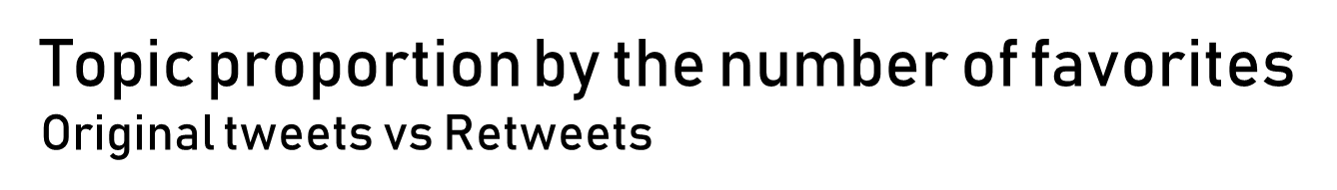
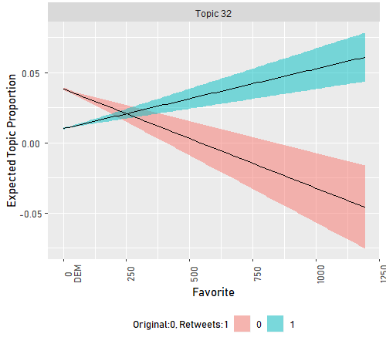
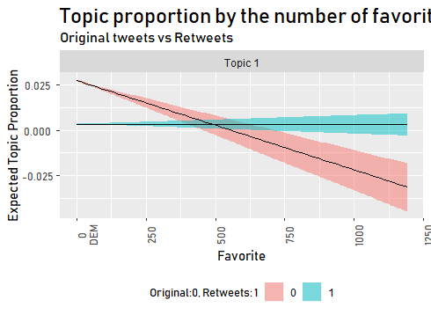
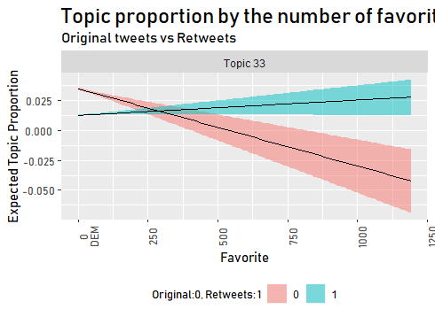
T32: Veteran’s day and gift card
T1 and 33: Dollar zombie

Slide 30
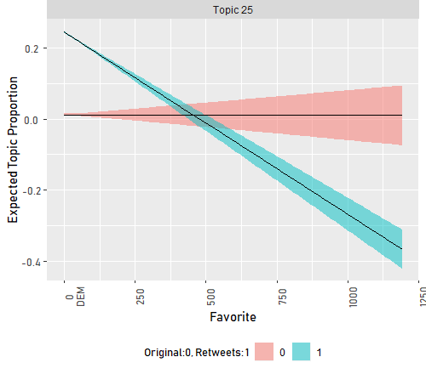
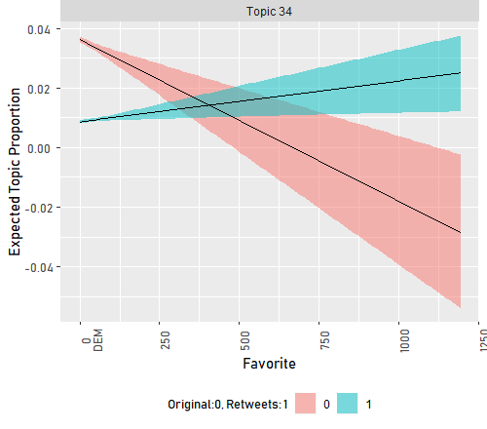
T25: Parking lot
T34: Discrimination

Slide 31

Thank You

